Slide 1
Hypothesis Testing
A scientific approach to asking and answering questions

Slide 2
Getting started
Researchers in any discipline should begin a study with some kind of generalization about how a system should work.
The generalization usually involves an assumption about the relationship between two or more variables.
The generalization usually comes in one of two forms:
Research questions
Hypotheses

Slide 3
Research questions
Used in exploratory studies when there is not enough theory or observations exist from which to generate a hypothesis
Used to search for patterns
Cannot be tested directly
Answers can lead to hypothesis development

Slide 4
Hypotheses
A formal statement about the relationship between two or more variables
Is tested directly

Slide 5
Benefits of hypotheses
Provide direction for a study
Knowing hypothesis/hypotheses to be tested is essential in efficient study design
Eliminate trial-and-error research
Help rule out intervening and confounding variables
Allow for quantification of variables

Slide 6
A good hypothesis
Is compatible with current knowledge
Or has sound reasons to be contrary with current knowledge
Is logically consistent
Is succinct
Is testable

Slide 7
The null hypothesis
A null hypothesis means there is no relationship or no effect.
The null hypothesis (H₀) is the one put to statistical test, not the research hypothesis (H₁).
Researchers accept or reject the null hypothesis based on the study’s results.

Slide 8
Alphas
An alpha level is an arbitrary significance level against which the null hypothesis is tested.
It is an accepted probability of obtaining a specific result by chance.
Essentially all things are possible, but that doesn’t mean all things are meaningful.
An alpha is set to minimize the chance of getting a false result by chance.
The default alpha is usually 0.05—in other words, the odds of getting a false result are no more than 1 in 20

Slide 9
How many tails?
The zone of rejection is the area under a sampling distribution in which the null hypothesis is rejected.
In a two-tailed test, the zone of rejection is split in two—one half at either side of the population mean.
In a one-tailed test, the zone of rejection is entirely on one side of the population mean.

Slide 10
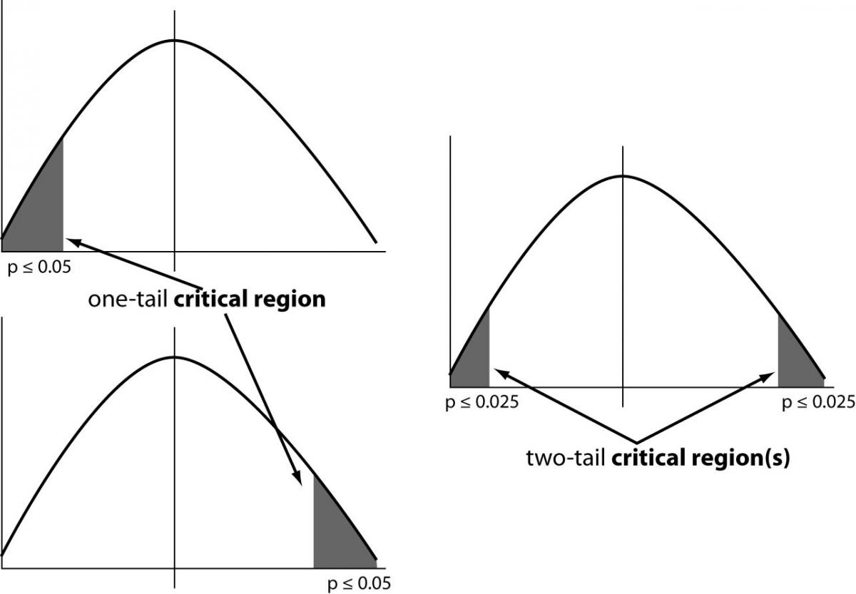
From Marusteri, Marius, and Bacarea, Vladimir, (2010). Comparing groups for statistical differences: how to choose the right statistical test? Biochemia Medica 20(1), 15-32.

Slide 11
Significance
In statistical terms, significance has nothing to do with importance.
A statistically significant result is one that is unlikely to have occurred by chance (as defined by the alpha level).
If alpha = 0.05, a statistically significant result is one where there is no more than a 1-in-20 chance of obtaining the results by chance.

Slide 12
Caveats
A significant result does not mean much unless supported by sound theory.
Context is key.
If a study is properly designed and conducted, a failure to reject the null hypothesis can be a very important result.

Slide 13
Error
When you reject a null hypothesis that should be accepted, you have a Type I (or alpha) error.
Type I error is controlled by the selection of the alpha level for the test.
When you accept a null hypothesis that should be rejected, you have a Type II (or beta) error.
Type II error is controlled by the design of the experiment.

Slide 14
Power
Power is a measure of the ability to detect a difference or effect that exists.
Power is a function of the probability (alpha) level, sample size, and effect size.
Power is typically controlled by selection of the sample size.
i.e., the larger the sample, the greater the power.

Slide 15
Sample: A lady tasting tea
In 1919, a researcher working at the Rothamsted Experimental Station, Muriel Bristol-Roach, claimed to be able to tell by taste whether tea was poured before milk or vice versa.
One of her colleagues, Ronald A. Fisher, devised a test of her claim.
Fisher’s account of the test helped lay the foundation for modern hypothesis testing.

Slide 16
Sample: Environmental agendas
Compares sources of environmental information provided to environmental journalists to determine if public relations sources are more likely to promote a backlash agenda and lack news value.
Sources:
Public relations materials
Tipsheets provided by the Society of Enviornmental Journalists.
Tested five specific hypotheses using a content analysis of source materials.

